Slide 1

Final Project:
Airline Satisfaction
Cindy Acuna, Luis Osorio,
Maria Sanchez-Beltran, & Tammy Huynh
Dr. Xiyue Liao
Stat 473

Slide 2
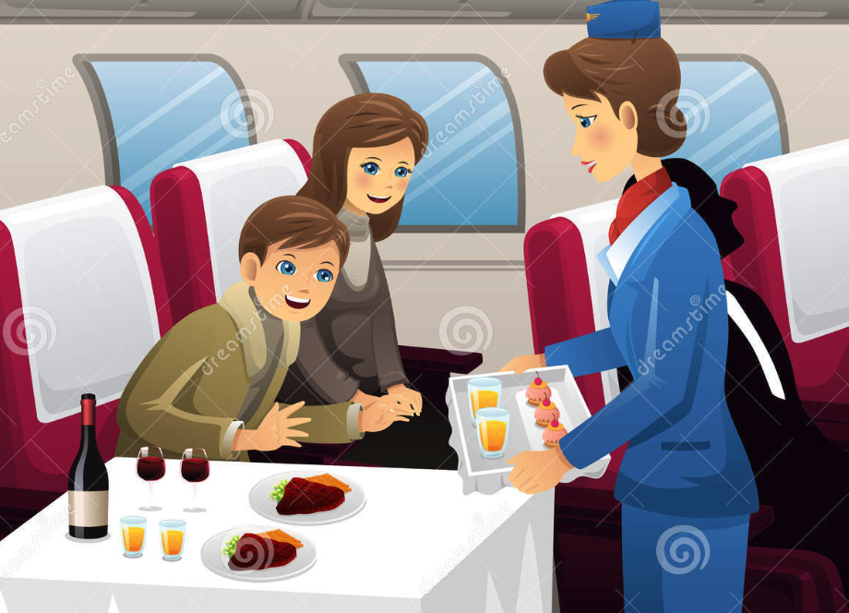
Introduction & Background
Measuring customer satisfaction is vital for businesses
Understanding customer expectations can help improve quality service
Airlines need to develop a specific mechanism to help them identify satisfaction measurements
The Data Set: 2015 Survey on Airline Passenger Satisfaction Level https://www.kaggle.com/datasets/teejmahal20/airline-passenger-satisfaction
Notes:
Tammy

Slide 3

Notable Features
Categorical Features: Satisfaction, Gender, Customer Type, Class, and Travel Type
Numeric Features: Flight Distance, Age, Departure Delay in minutes and Arrival Delay in Minutes
Target Variable: Satisfaction (imbalanced classes)
Binary Classification Problem: 2 classes
Satisfied Passengers or Neutral/Dissatisfied PAssengers

Slide 4
Question of Interest
1. What are the statistically significant predictors for each of the machine
learning models?
2. How does each model handle imbalance classes in the response variable?
3. What machine learning algorithm produced the highest accuracy in determining airline satisfaction level?
Notes:
Tammy

Slide 5
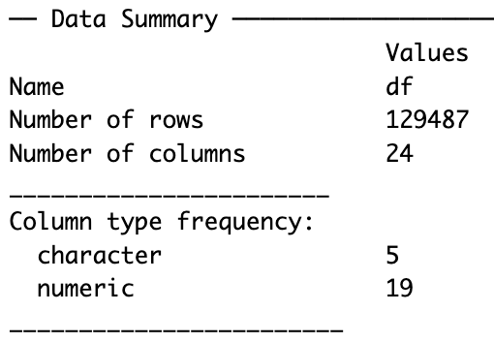
Exploratory Data Analysis
A total of 24 features and 129,880 observations
Dropped 393 rows that contained missing values
Check column data types and changed target variable into a Factor (creates levels for categorical variables)
Changed column names for simplicity and variable name conventions

Slide 6
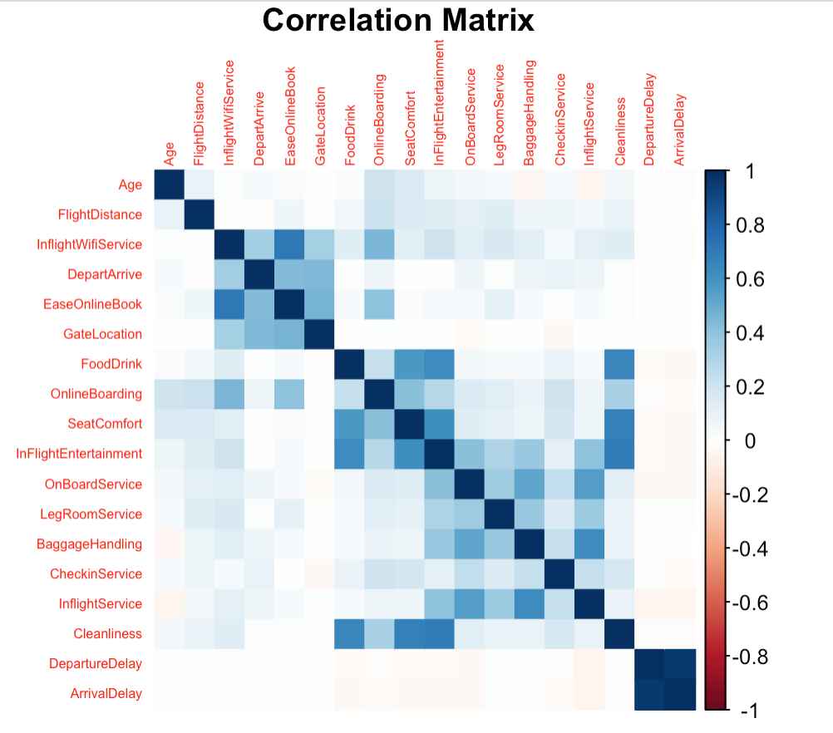
Correlation Matrix
Seat Comfort had a positive relationship with between food/drinks, in flight entertainment, and cleanliness
Positive relationship if we increase one variable the other variable increases.
Dark blue indicates positive correlation
Notes:
Luis

Slide 7
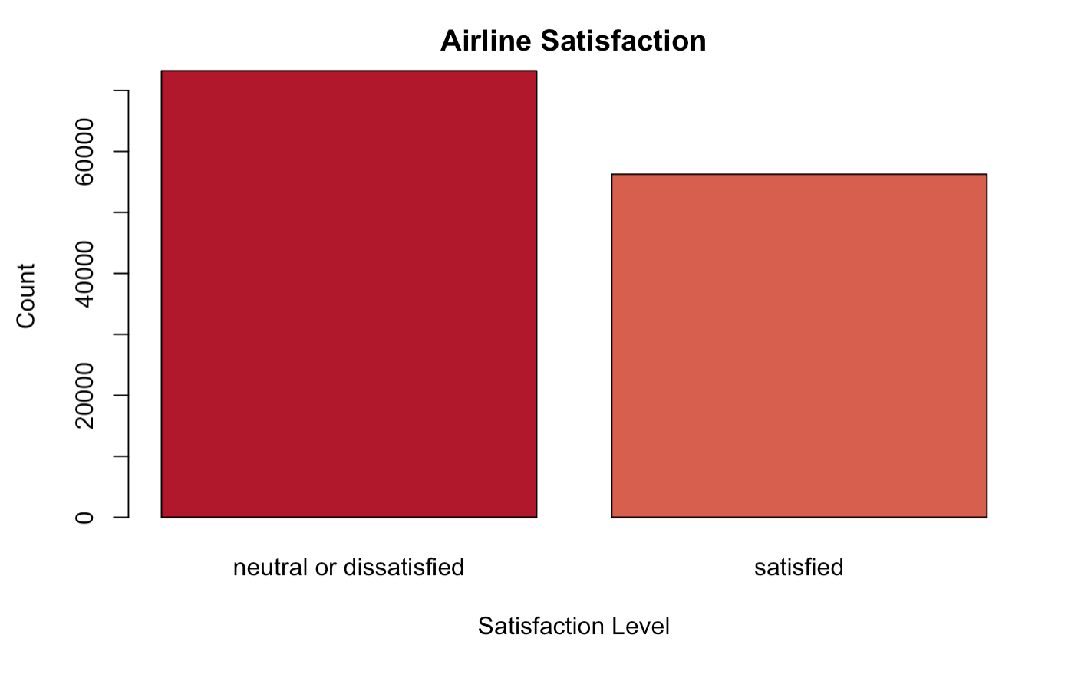
Visualizations
Satisfaction Bar Chart
Observe the Slight class imbalances between satisfied and neutral/dissatisfied passengers
We Have more Neutral/Dissatisfied in our data set
Recall our 2nd research Question
Notes:
Cindy

Slide 8
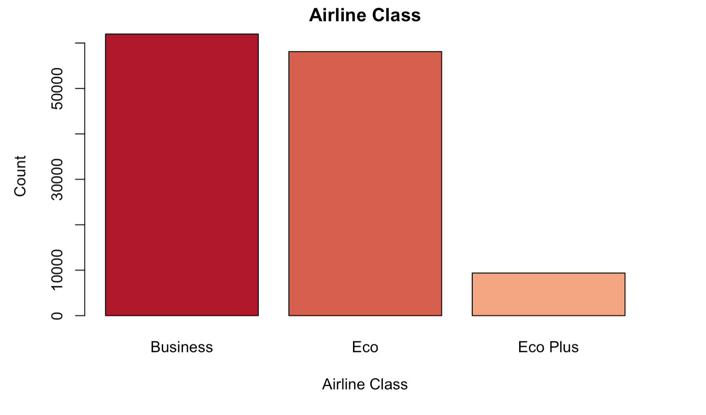
Airline Class Bar Chart
Majority Passengers bought business and Eco fares compared to Eco Plus fares
We have to ask why this is the case?

Slide 9
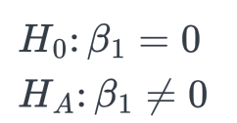
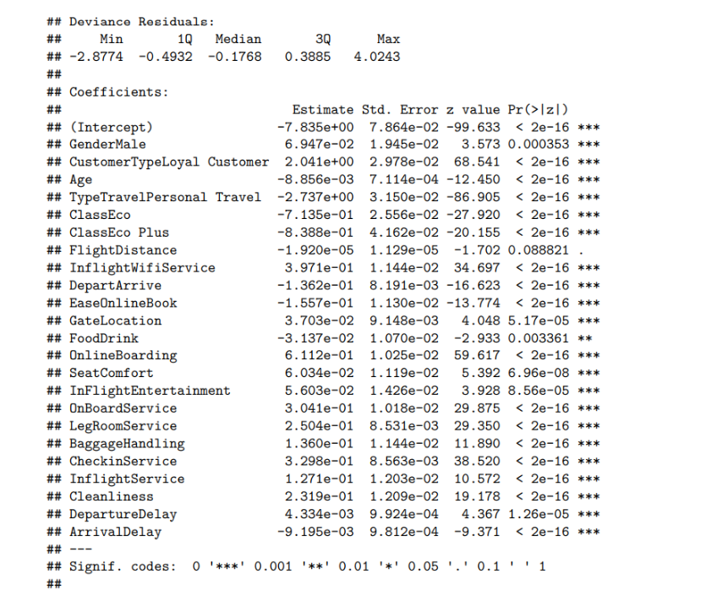
Model 1: Logistic Regression
Logistic Regression significant predictors
Only Flight Distance was not significant
All other variables are statistically significant

Slide 10
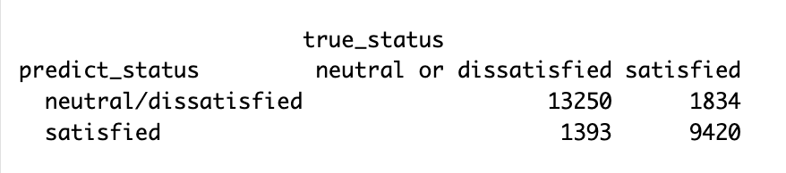
Model 1: Logistic Regression: Metrics
Accuracy = 87.5%
Sensitivity = 90.5%
Specificity = 83.7%
Recall our target variable had imbalance classes
Confusion Matrix Using Testing Set

Slide 11
Model 1: Logistic Regression
Q1 ans:
Flight Distance was the only statistically insignificant predictor in our model, thus we can remove it
Q2 ans:
Since the data was slightly unbalanced with higher Dissatisfied or Neutral, Sensitivity is higher than specificity

Slide 12
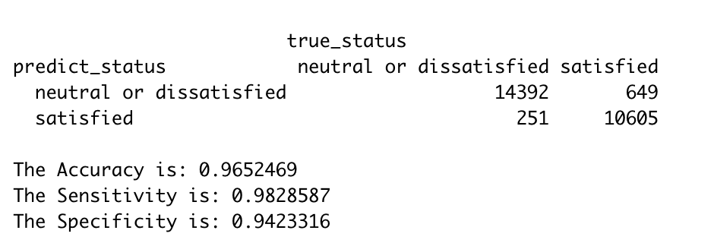
Model 2: Random Forest Classifier
Question 3:
96.5% Accuracy
98.2% Sensitivity
94.2% Specificity
Question 2:
The data set is relatively balanced
14,643 neutral/dissatisfied cases
11,254 satisfied cases.

Slide 13
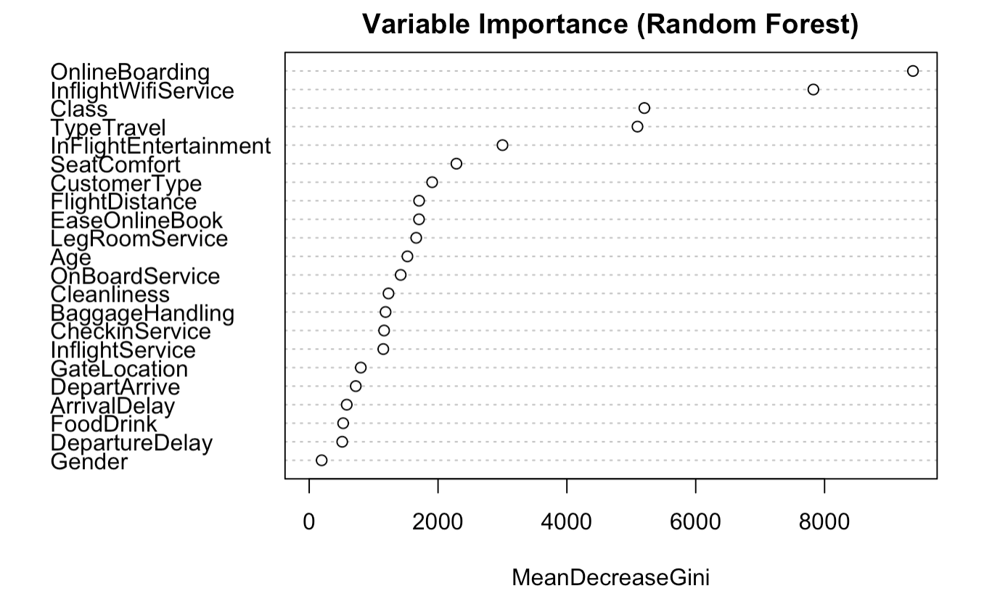
Random Forest: Important Predictors
Question 1:
Higher value of mean decrease gini score, the higher the importance of the variable in the model
Top 4 Important features
OnlineBoarding
Inflight/Wifi
Class
Type Travel

Slide 14
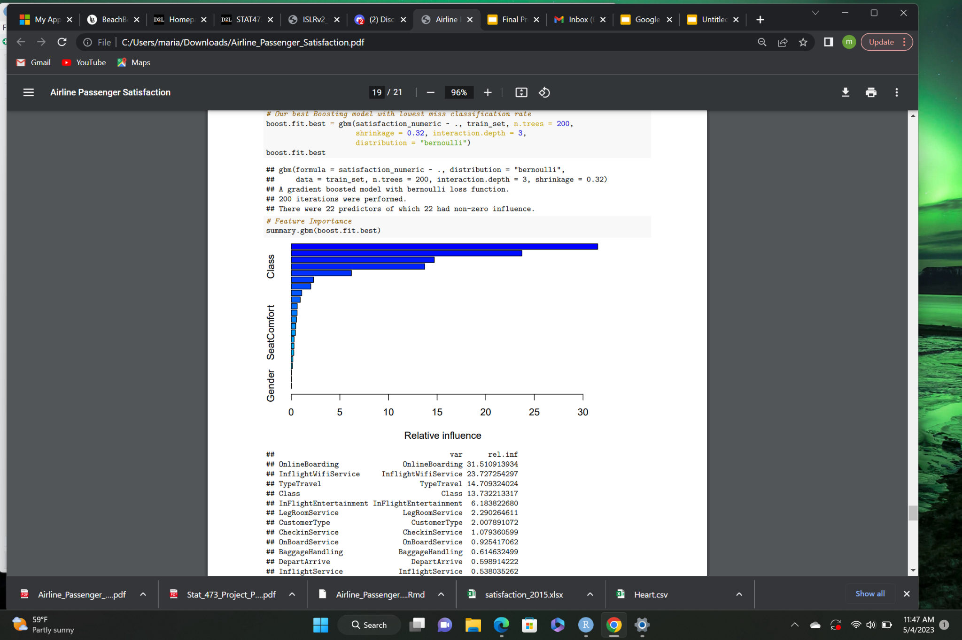
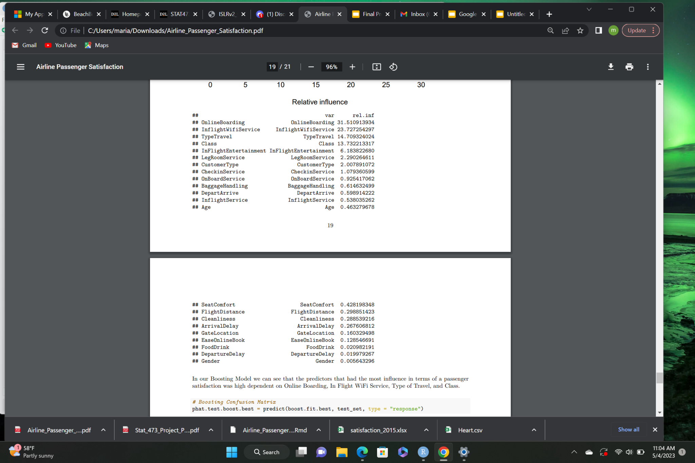
Model 3: Boosting
Predictors with the most significance:
- Online Boarding - Inflight Wifi Service - Type Travel - Class
Code was modified to be read into binary classification by changing satisfied and unsatisfied to 1 and 0.

Slide 15
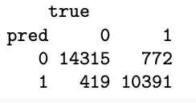
Model 3: Boosting
Accuracy is: 0.9540101
Sensitivity is: 0.9715624
Specificity is: 0.930843
The data set is relatively balanced in the sense there is no hige difference between sensitivity and specificity rate.
Neutral/Dissatisfied is 14734 and the satisfied is 11,163.

Slide 16
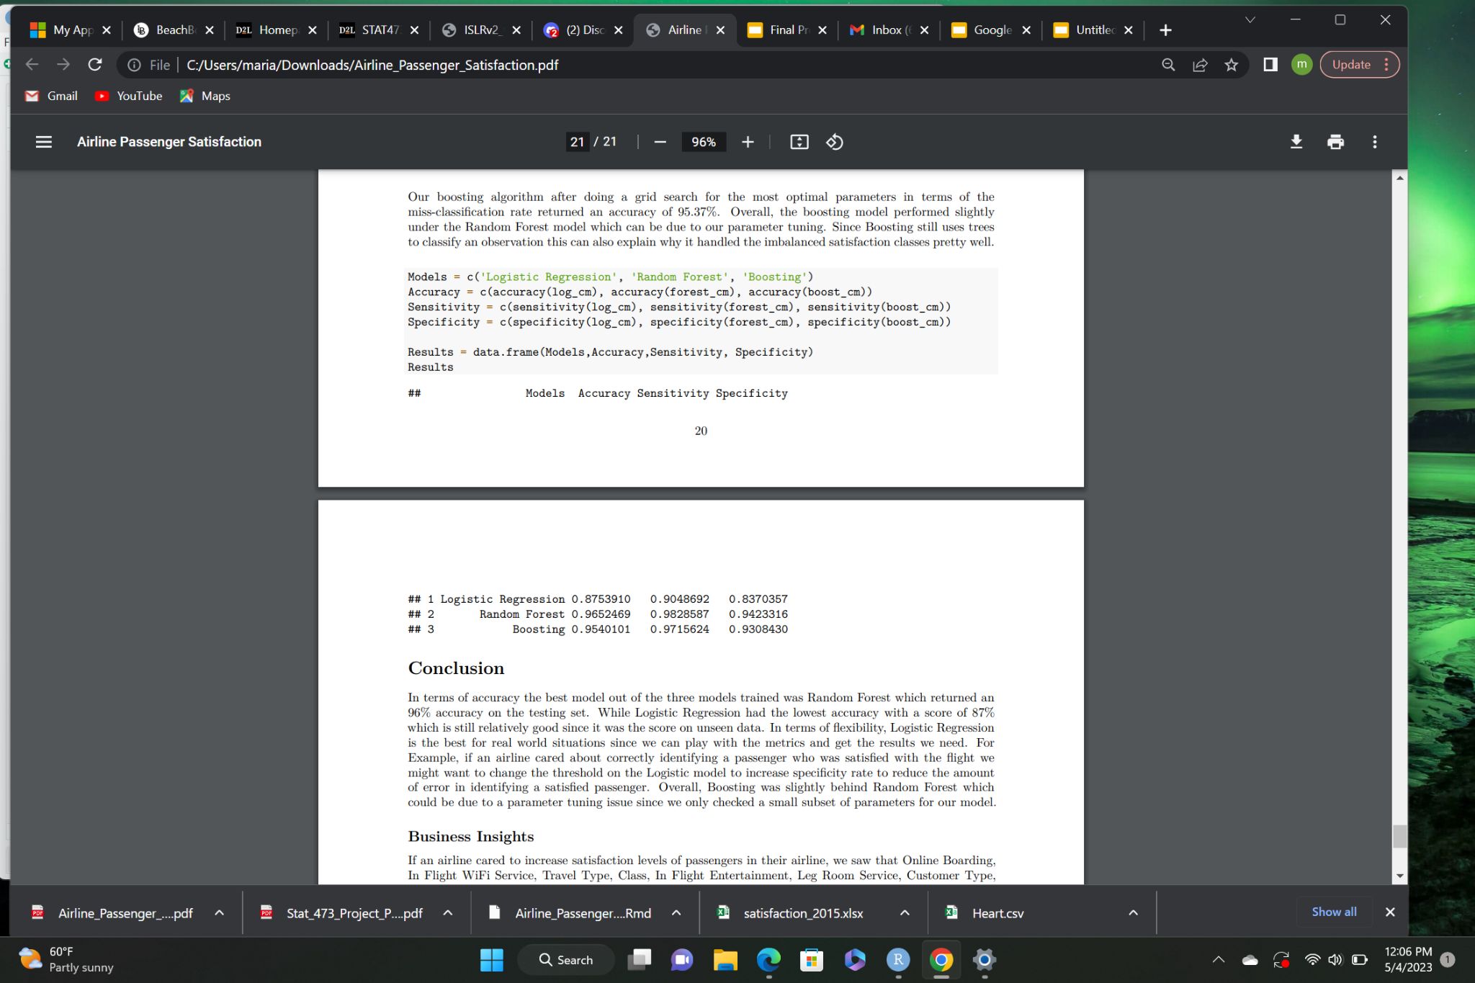
Conclusion
The best results were brought out by Random Forest as it projected a 96% accuracy.
Logistic regression gave us a 87% accuracy.
Meanwhile Boosting gave us a 95.4% accuracy.

Slide 17

Business Insights
Why determine the significant predictors?
If an Airline wishes to improve satisfaction level we use the important variables in our models and choose the ones we can control
For Example:
Online Boarding: make airline tasks online
In Flight Wifi Service: provide wifi for everyone
Check In & On Board Service - improve service quality

Slide 18
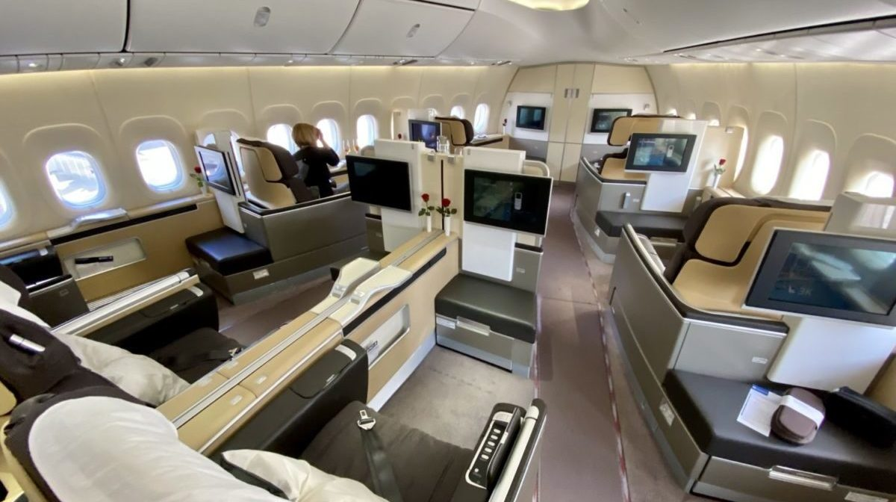
THANK YOU!

